Slide 1
INTRODUCTION
An Online Library for Students is a web-based platform designed to provide students with access to a wide range of educational resources, including books, journals, and documents. This platform helps students search, view, and manage their academic materials efficiently while supporting personalized learning experiences. The system emphasizes simplicity, accessibility, and effective organization to cater to diverse academic needs.

Slide 2
LITERATURE SURVEY
Students must refer 5 papers and summarize it. (content font Size 24 Times New Roman )
2 papers should be summarized in one slide

Slide 3
PROBLEM STATEMENT
In traditional libraries, students often face difficulties accessing specific resources due to time constraints and unavailability. There is a need for a centralized, accessible, and user-friendly platform that caters to the growing demand for digital educational resources, providing efficient organization and enhanced accessibility.

Slide 4
OBJECTIVES
Design a user-friendly system for seamless navigation.
Develop secure login and user management systems.
Provide personalized and categorized content to enhance the user experience.
To improve students’ research skills and academic performance through easy access to high-quality resources.

Slide 5
HARDWARE AND SOFTWARE REQUIREMENTS
Hardware Requirements:
PC with Intel i3 processor or higher.
4 GB RAM, 500 GB HDD/SSD.
Software Requirements:
OS: Windows/Linux.
Database: MongoDB.
Frontend: HTML, CSS, JavaScript.
Backend: Node.js/PHP.

Slide 6
METHODOLOGY
Step 1: Requirement Analysis
Gather system requirements from students and faculty.
Step 2: Database Design
Define schemas for users, resources, and activity logs.
Step 3: Frontend Development
Build intuitive interfaces with responsive designs.
Step 4: Backend Development
Develop APIs to handle user requests and resource queries.
Step 5: Integration and Testing
Ensure seamless integration and rigorous testing of features.

Slide 7
APPLICATIONS
Access to academic resources from any location.
Supports online and offline reading.
Helps manage personal library collections.
Encourages self-paced learning for students.
Facilitates resource sharing within educational institutions.

Slide 8
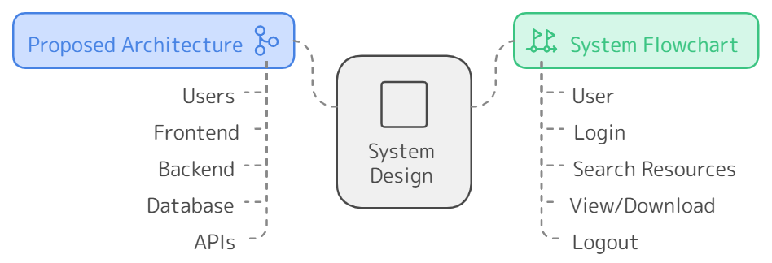
SYSTEM DESIGN
System Flowchart:
User --> Login --> Search Resources --> View --> Logout.

Slide 9
ALGORITHMS
Description of the algorithms identified

Slide 10
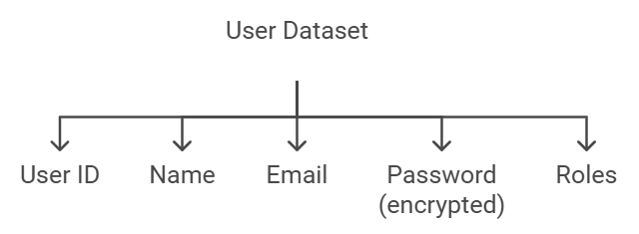
DATASETS
User Dataset:
Attributes: User ID, Name, Email, Password (encrypted), Roles.

Slide 11
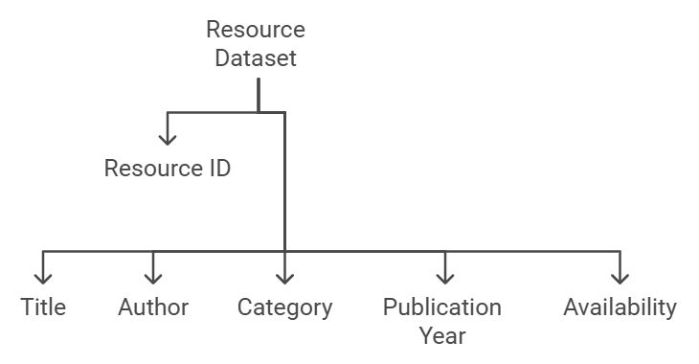
DATASETS
Resource Dataset:
Attributes: Resource ID, Title, Author, Category, Publication
Year, Availability

Slide 12
IMPLEMENTATION
Students should show the implementation work carried out
Include snapshots

Slide 13
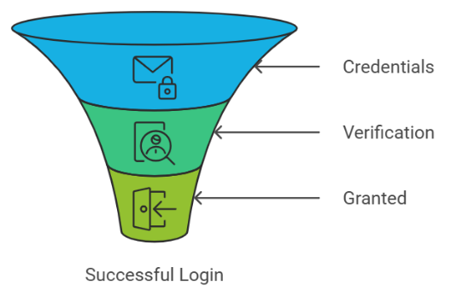
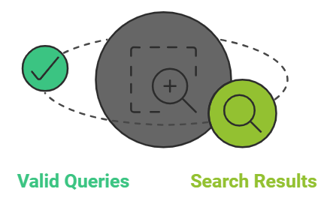
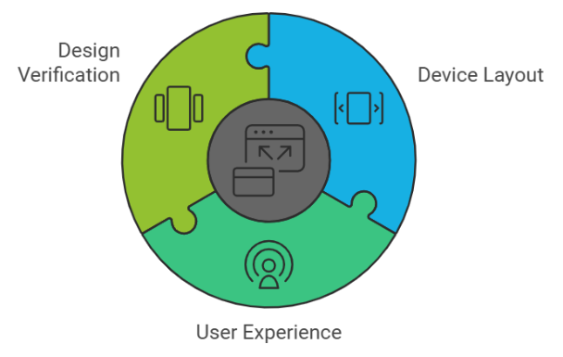
SYSTEM TESTING
User Authentication:
Verify User Login with Valid Credentials
Search Functionality:
Verify search results for valid queries.
Responsive Design:
Verify website layout on mobile devices.

Slide 14
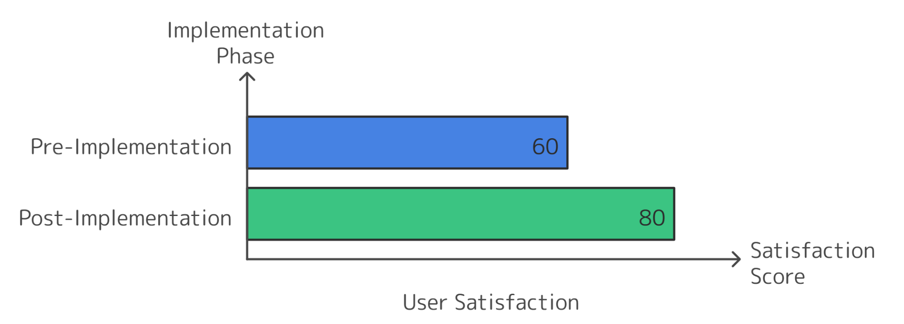
RESULT ANALYSIS
Graph showing user satisfaction pre- and post-implementation.
Reduced time to access resources.
Increased engagement metrics.

Slide 15
CONCLUSION & SCOPE FOR FUTURE WORK
Conclusion: The project successfully achieves its objective of providing a centralized online library for students. Its user-friendly design and powerful search mechanisms enhance academic productivity.
Future Scope:
Integration of AI-powered recommendations.
Multilingual support for global accessibility.
Expansion to include audio and video resources.

Slide 16
REFERENCES
Roy, Amit and Sharma, Ankita, Digital Libraries and Modern Education (2021). Proceedings of International Conference on Educational Technology, Indian Institute of Technology (IIT), Delhi, India, March 12-14, 2021.
Mehta, Sahil, UI/UX Design Principles for E-Learning Platforms (2022). ACM Symposium on Design Innovations, University of Cambridge, UK, February 5-7, 2022.
Khan, Nadeem, Security Challenges in Digital Libraries (2018). Proceedings of Springer International Conference on Cybersecurity in Digital Systems, National University of Singapore, Singapore, November 22-24, 2018.

